Slide 1


M.Tech/MCAProgram
Advanced Industry Integrated Programs
Jointly offered by University and LTIMindTree
Review II
Customer Churn Prediction & Retention System
Bhavyam Ramani
D003
Knowledge partner | Implementation partner

Slide 2
Project Title - Calibri body 18
Introduction
Customer churn = loss of clients / subscribers.
Business lose 5-25 times more in acquiring new customers Vs retaining old ones.
Traditional Classification misses timing and actionable insights.
High churn causes revenue loss, need to predict WHEN and WHY customers leave, not just WHO leaves.
Existing churn models often only give Yes / No churn outputs.
Business lack actionable insights to retain customers.

Slide 3
Project Title - Calibri body 18
Project Objectives
Predict churn probability (Yes/No) using ML classification models.
Predict time-to-churn using survival analysis.
Identify Top-5 churn reasons per customer with feature attribution.
Estimate Customer Lifetime Value (CLV) from survival probabilities.
Provide personalized retention recommendations.
Enable customer segmentation.
Build an interactive UI for churn risk, reasons, and retention strategies.
Ensure scalable, reproducible deployment with MLOps.

Slide 4
Project Title - Calibri body 18
Scope of Work
Collect and preprocess customer churn dataset (Telco).
Perform EDA and Feature Engineering to identify churn patterns.
Train ML classification models (Logistic Regression, Random Forest, XGBoost) for churn Yes/No prediction.
Implement survival models (Kaplan-Meier, Cox PH, DeepSurv) for time-to-churn prediction.
Generate personalized churn explanations (Top-5 reasons per customer using SHAP).
Perform customer segmentation with clustering based on survival curves.
Design retention strategies aligned with churn reasons.
Deploy system with MLOps (DVC, MLflow, Docker, CI/CD, Monitoring).

Slide 5
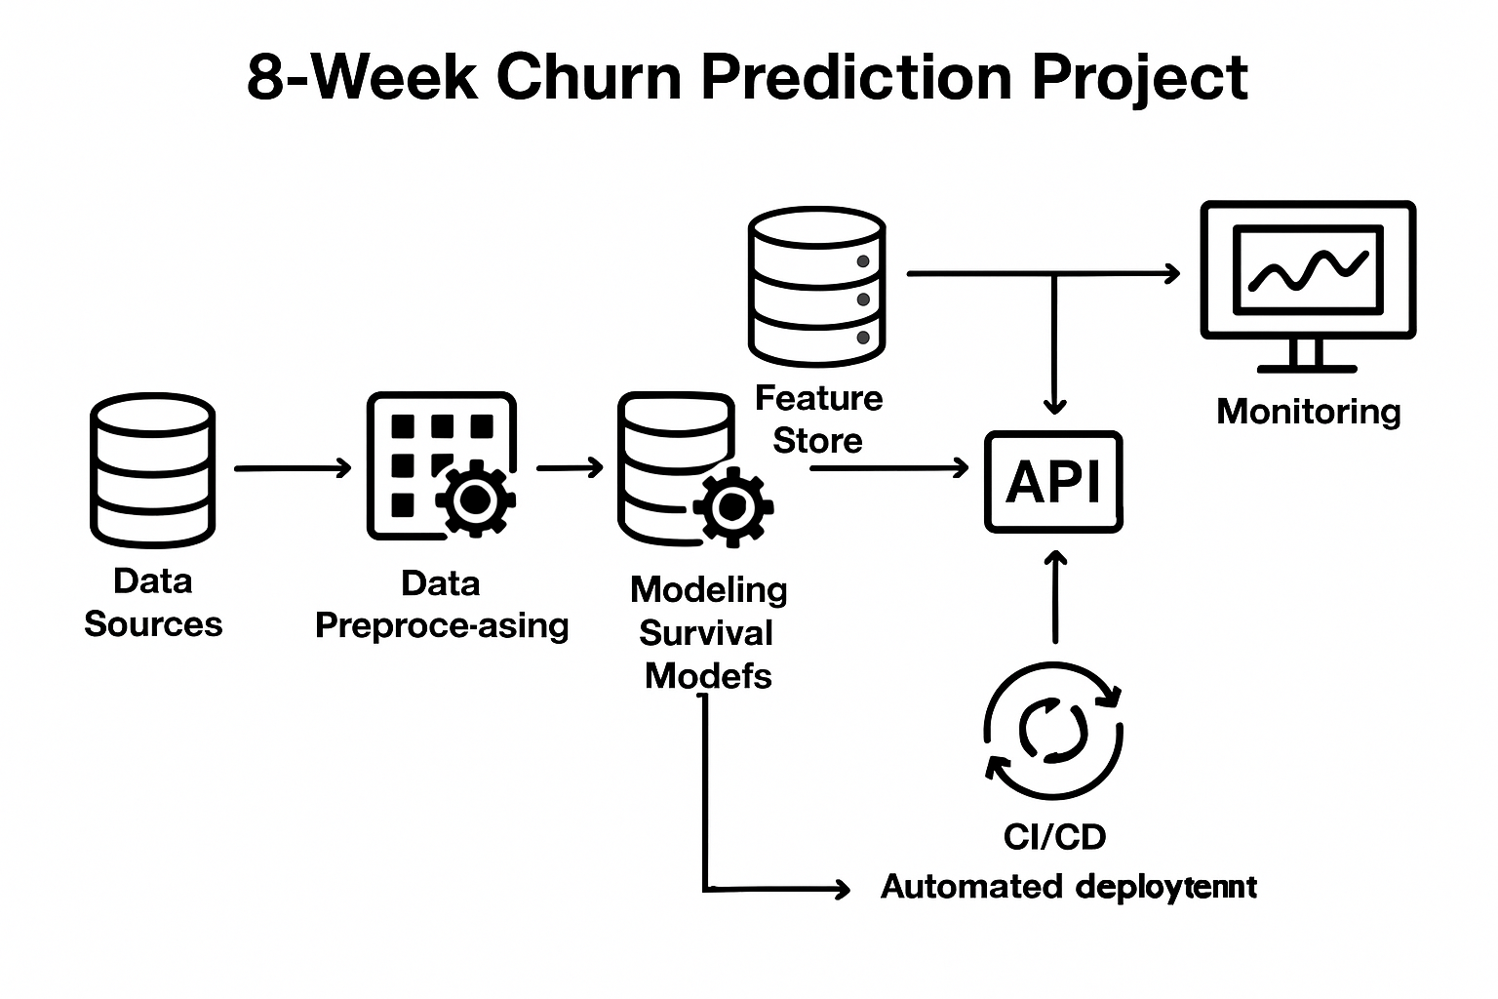
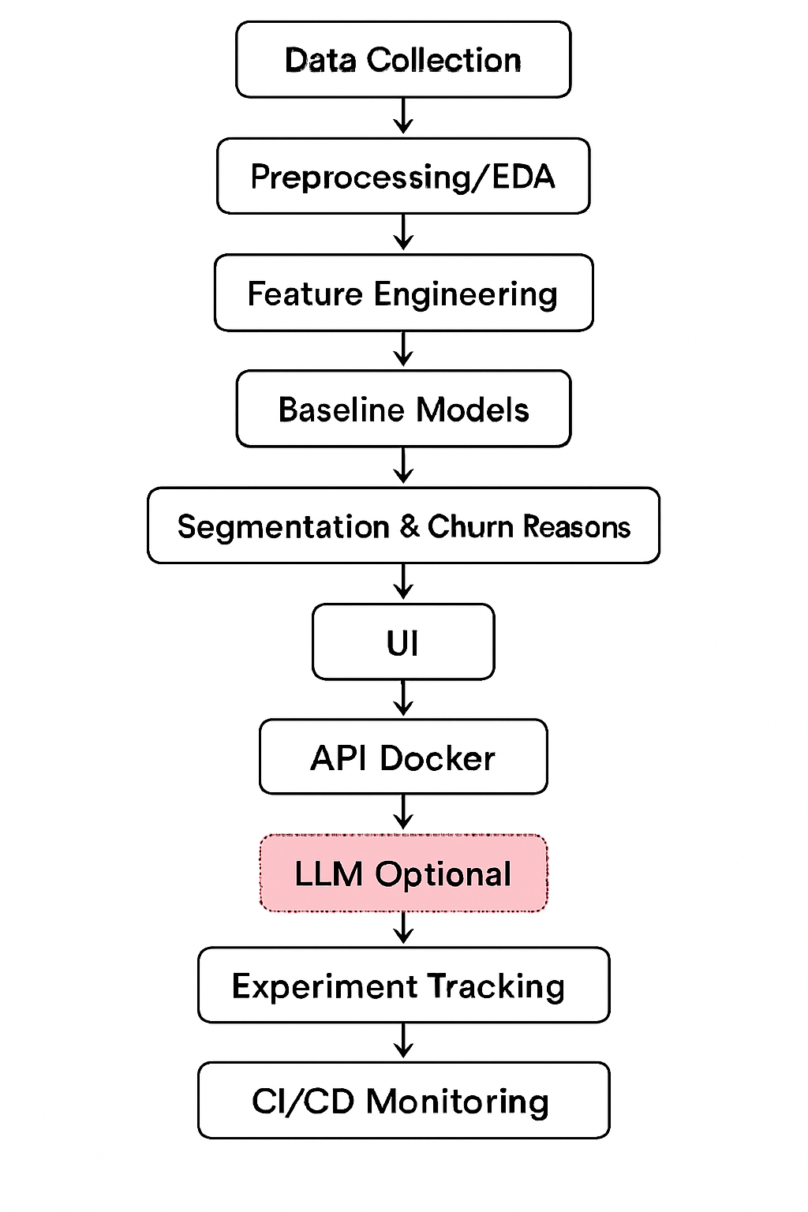
Project Title - Calibri body 18
Methodology / Model Plan

Slide 6
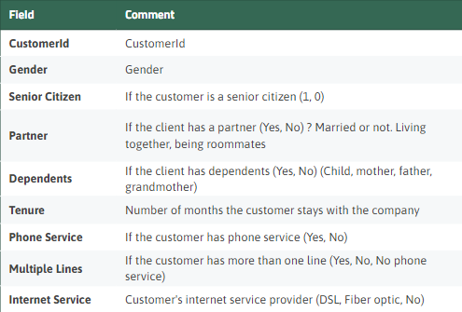
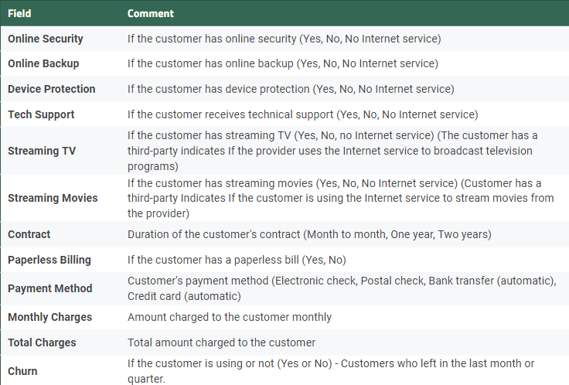
Project Title - Calibri body 18
Data preprocessing & EDA

Slide 7
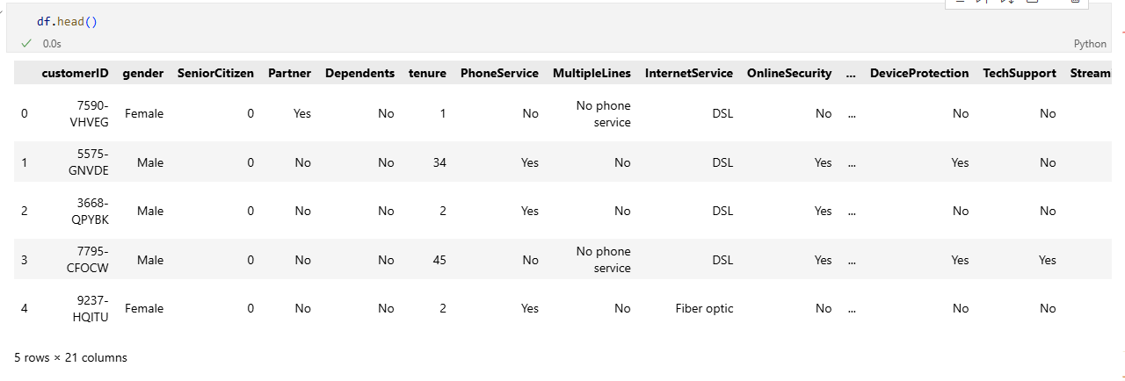
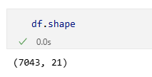
Project Title - Calibri body 18

Slide 8
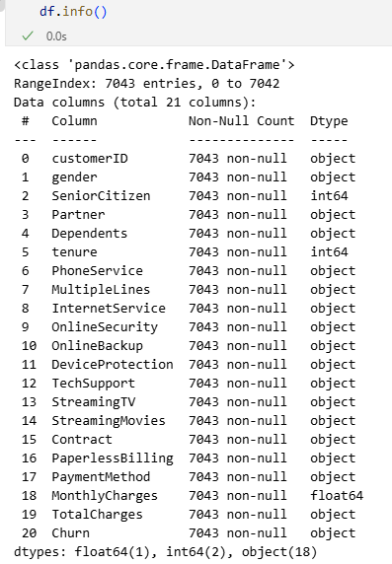
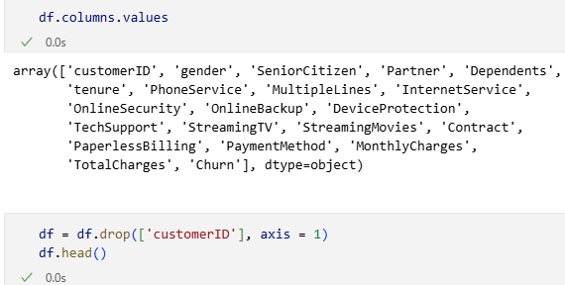

Slide 9
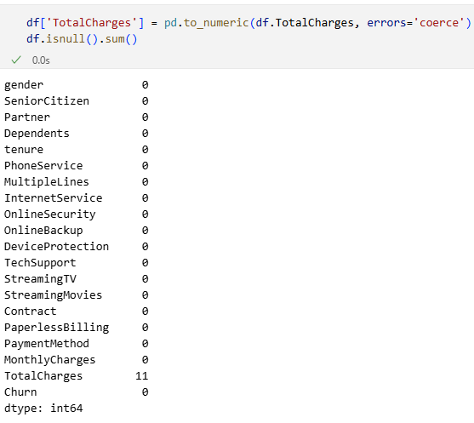
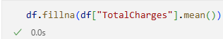
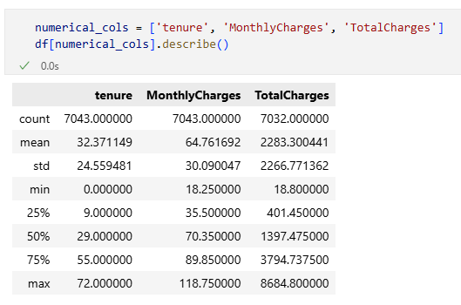

Slide 10
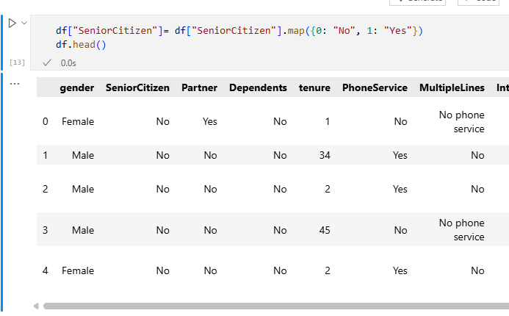

Slide 11
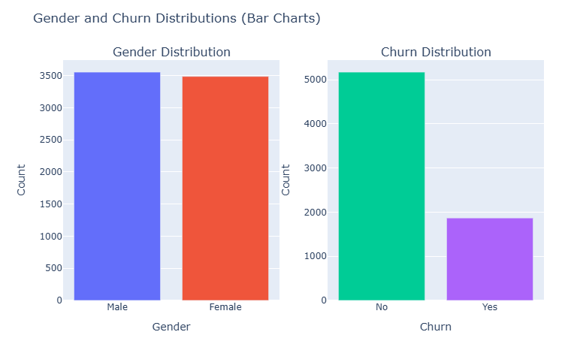
Churn Distribution based on Gender: There is almost no difference in the number or percentage of customers who switched their service provider based on gender. Both men and women behaved in the same way when it comes to migrating to another service provider.

Slide 12
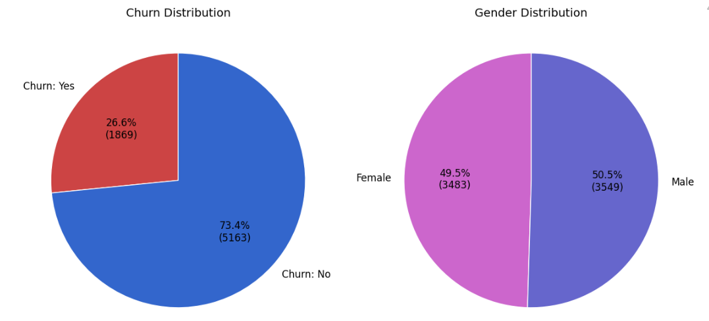

Slide 13
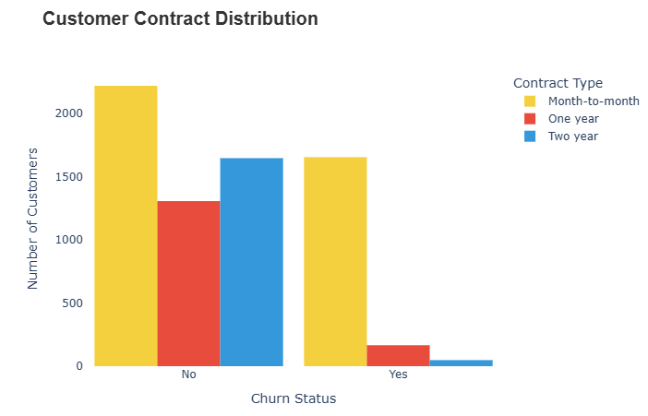
About 75% of customers with Month-to-Month contract opted to move out as compared to 13% of customers with One Year Contract and 3% with Two Year Contract.

Slide 14
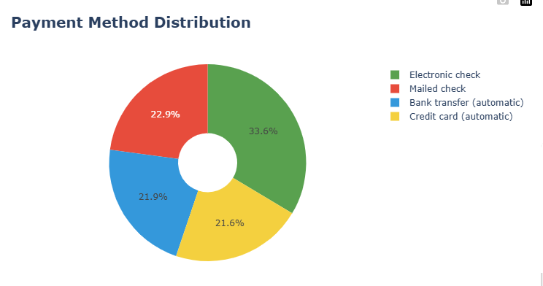
33.6% customers prefer payment method as Electronic Check.
22.9% customers prefer payment method as Mailed Check.
21.9% customers prefer payment method as Bank transfer (automatic).
21.6% customers prefer payment method as Credit Card (automatic).

Slide 15
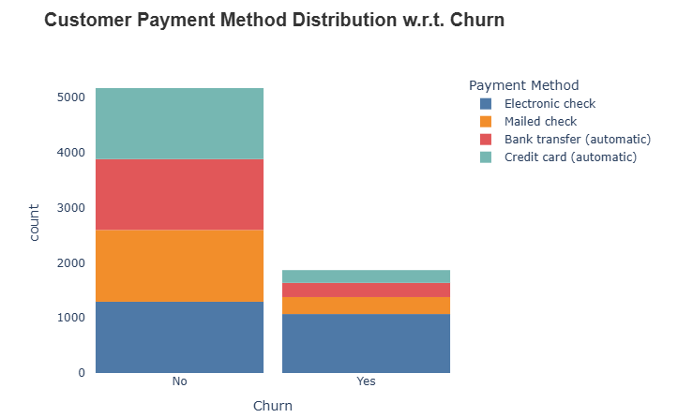
Customer Payment Method Distribution with respect to Churn: Major customers who switched to another service were having Electronic Check as Payment method.
Customers who opted for Credit card automatic transfer or Bank Automatic transfer and Mailed check as Payment method were less likely to move out.

Slide 16
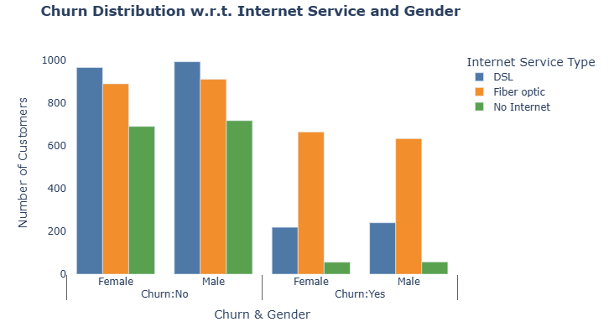
A lot of customers choose the Fiber Optic service and it’s also evident that the customers who use Fiber Optic have high churn rate, this might suggest a dissatisfaction with this type of internet service.
Customers having DSL service are majority in number and have less churn rate compared to Fibre optic service.

Slide 17
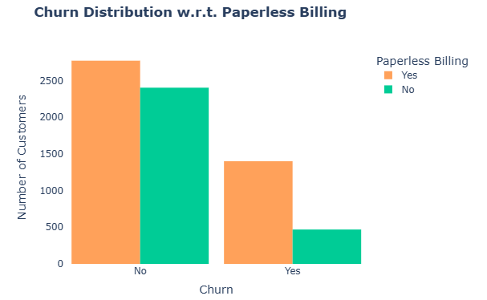
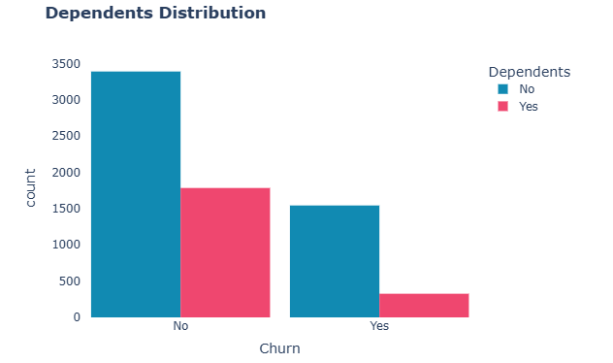
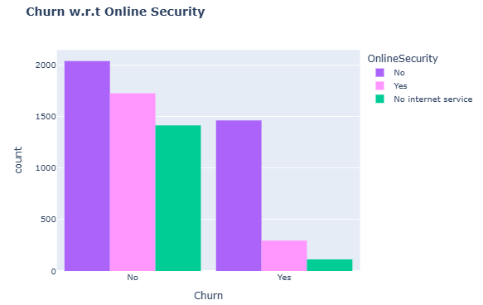
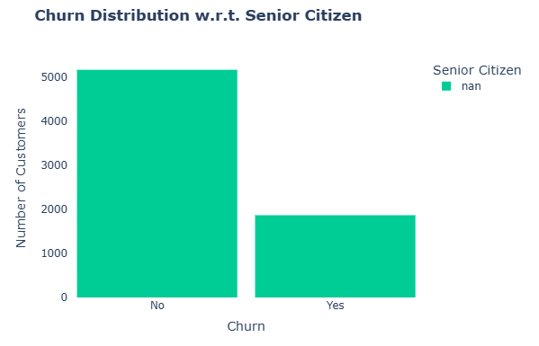
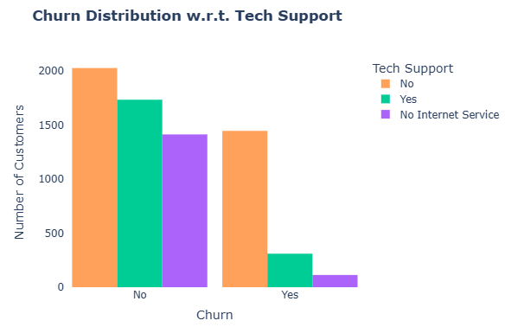
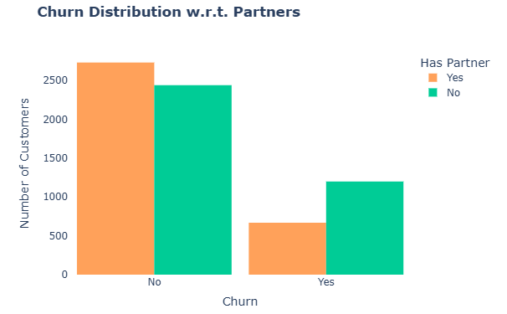

Slide 18
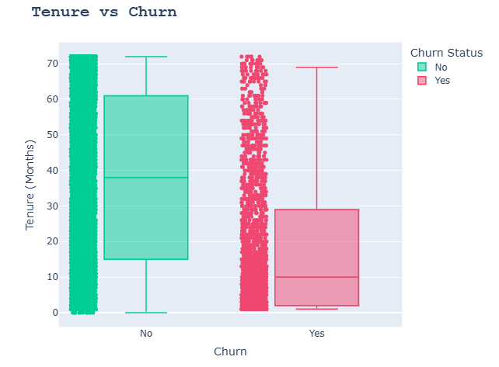
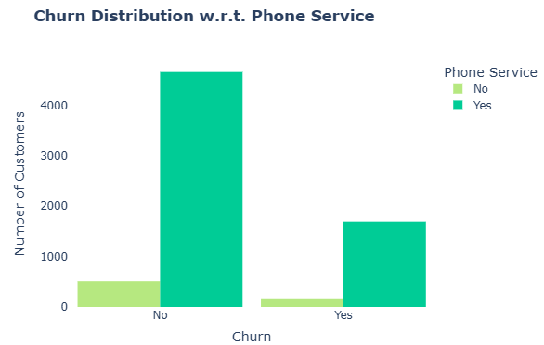
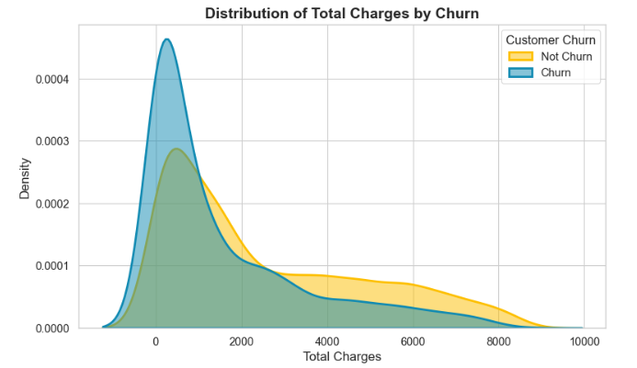
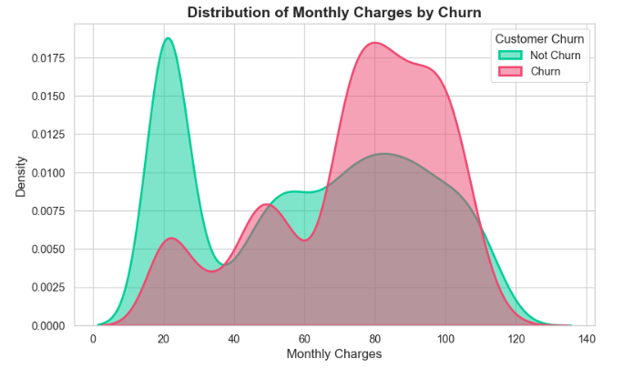
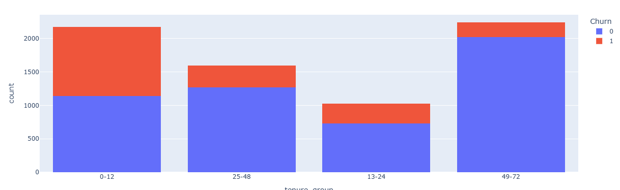

Slide 19
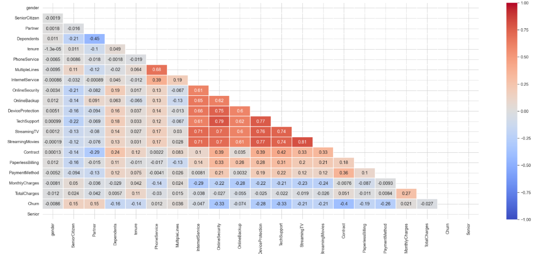

Slide 20
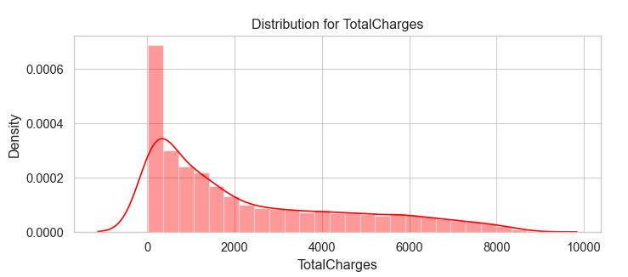
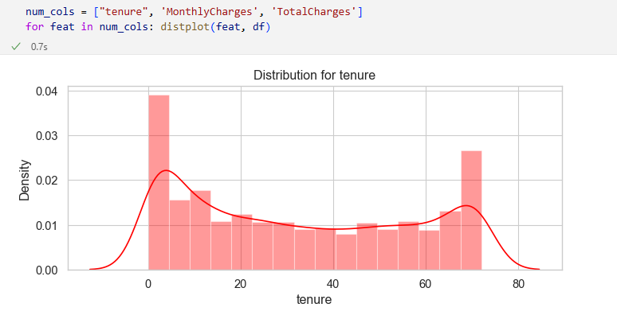
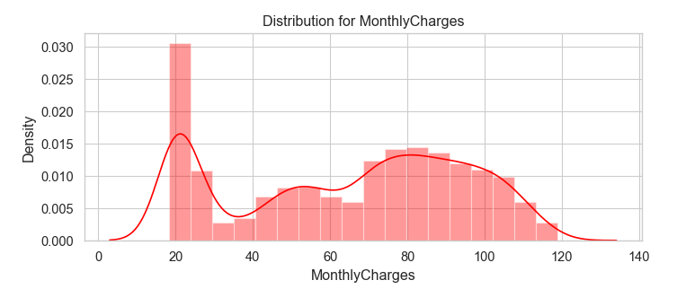
Used Standard Scalar to scale them down to the same range, since the numerical features are distributed over different value ranges
Used train_test_split to split to the data into train and test sets

Slide 21
Project Timeline And Tasks
Week 1: Data Collection, Requirement Analysis & Versioning Setup (DVC/MLflow)
Week 2: Data Preprocessing, EDA & Feature Engineering
Week 3: BASELINE MODELS + Kaplan-Meier + Cox Proportional Hazards Implementation
Week 4: DeepSurv Implementation & Hyperparameter Tuning
Week 7: Experiment Tracking (MLflow/W&B) + Model Registry Setup
Week 5: Top 5 Churn Reasons, Customer Segmentation & Retention Strategy
Week 6: UI Development (Streamlit) + API (FastAPI/Flask) + Dockerization
Week 8: CI/CD Integration, Cloud Deployment, Monitoring & Final Report

Slide 22
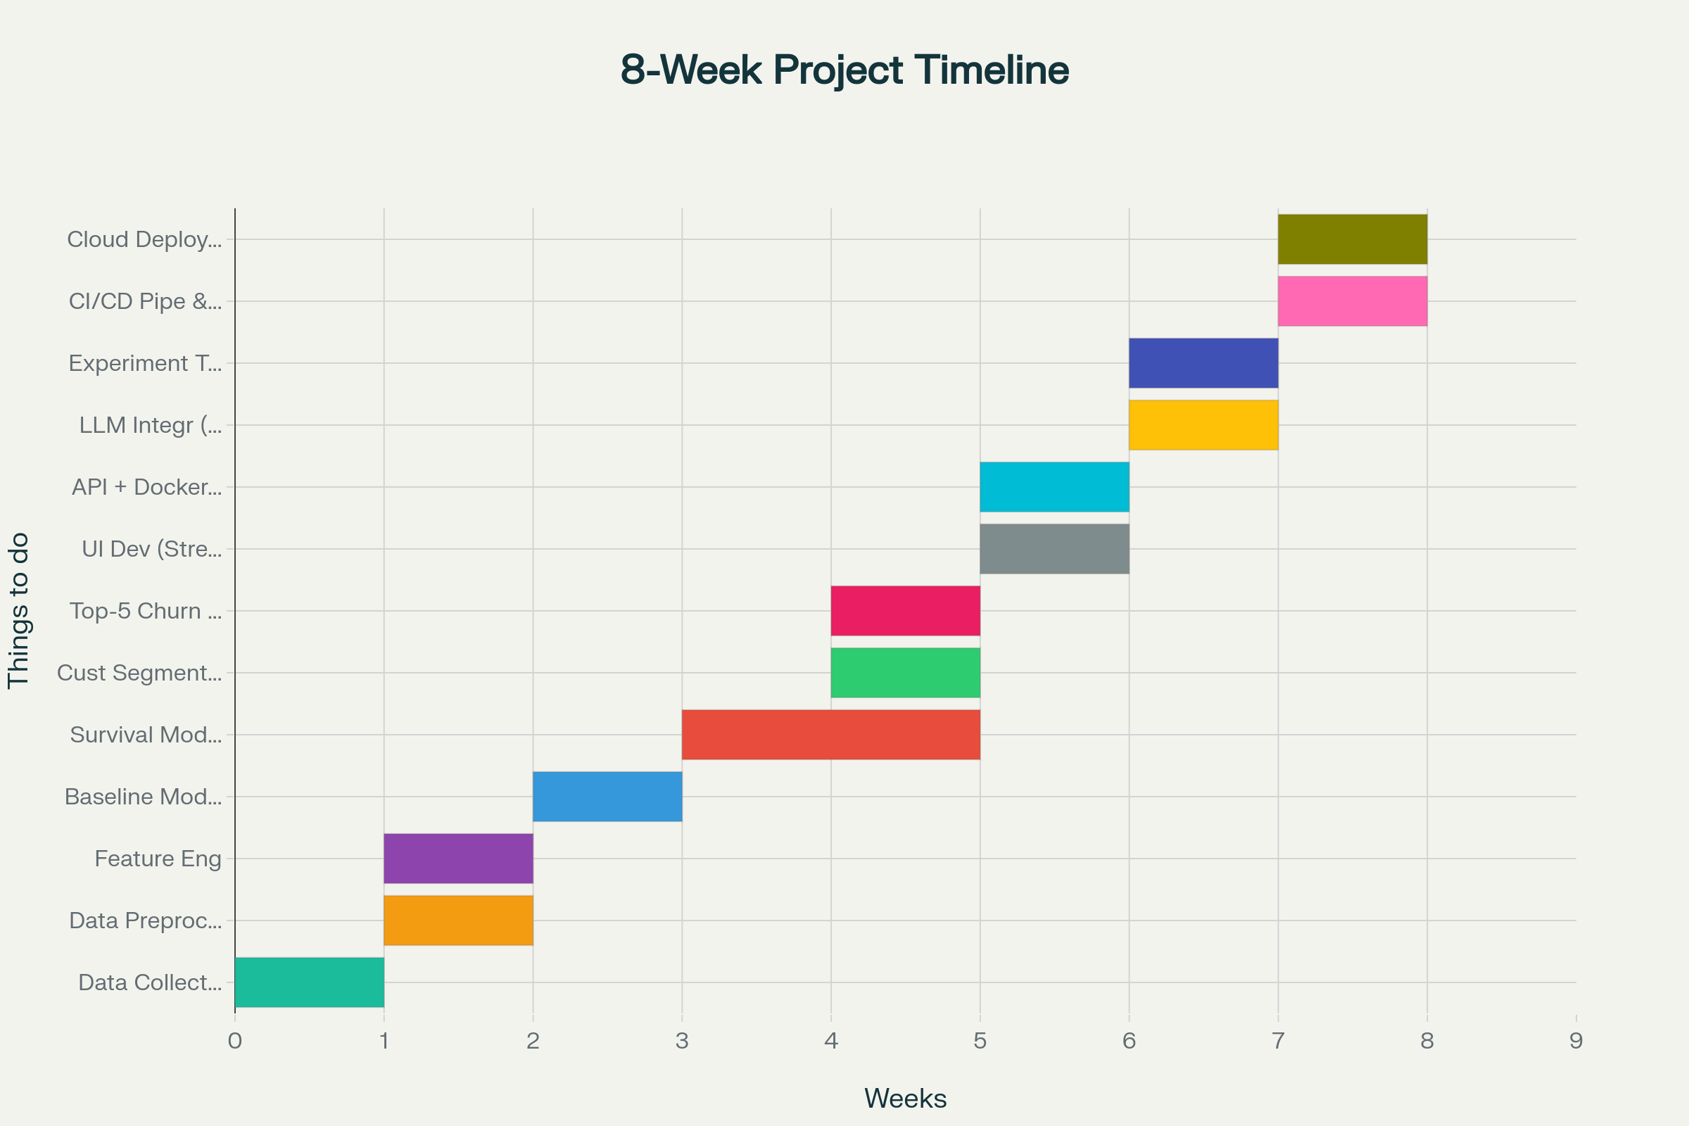

Slide 23
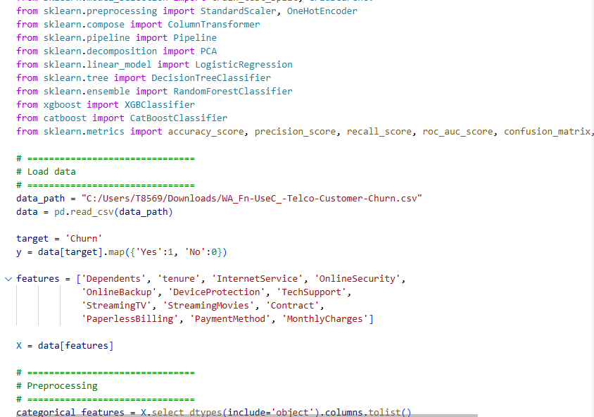
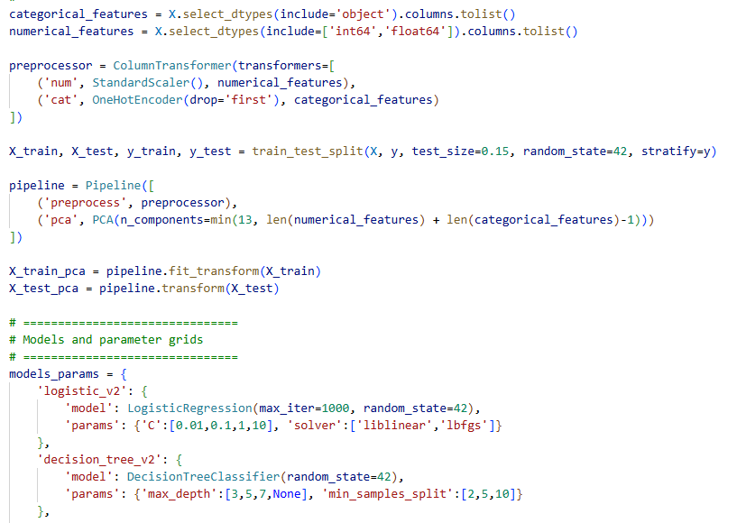
Project Title - Calibri body 18
Implementation (Code)

Slide 24
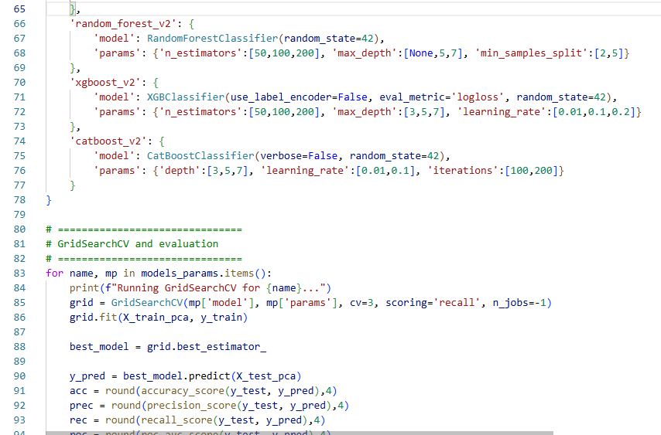

Slide 25
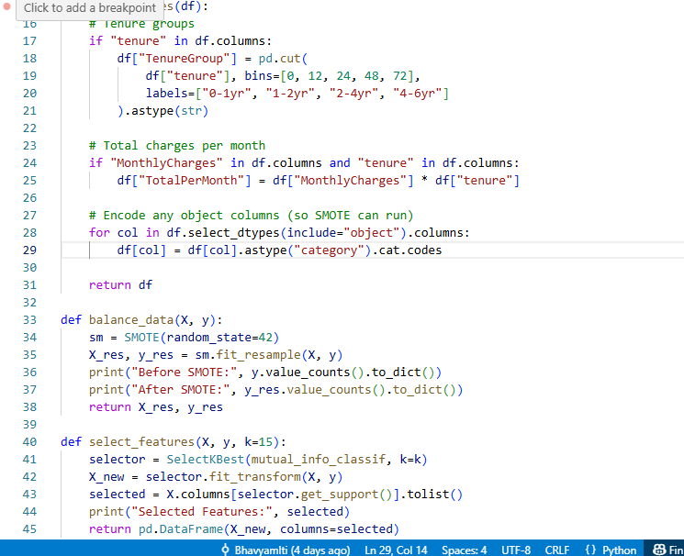
Applying SMOTE Analyis

Slide 26
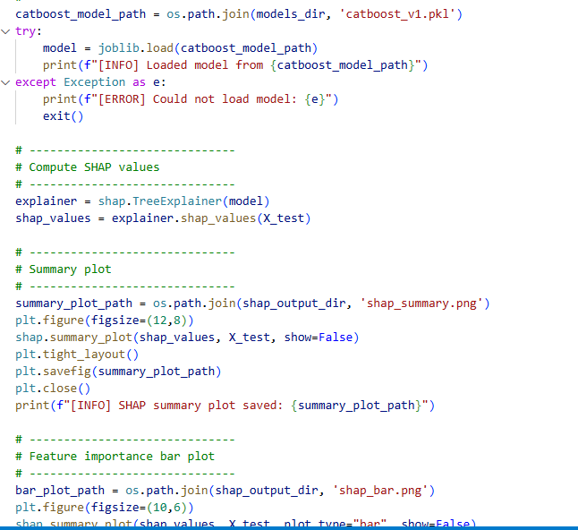
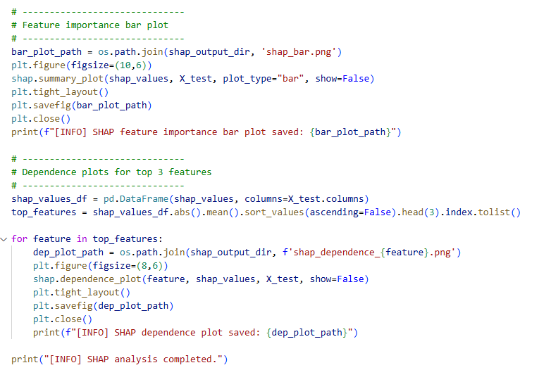
Performing SHAP Analysis to understand customer churn reasons

Slide 27
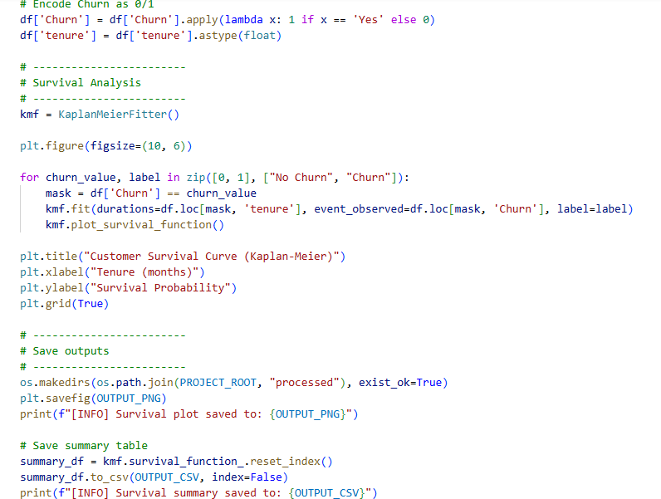
Survival Analysis using Kaplan Meier Survival Curves

Slide 28
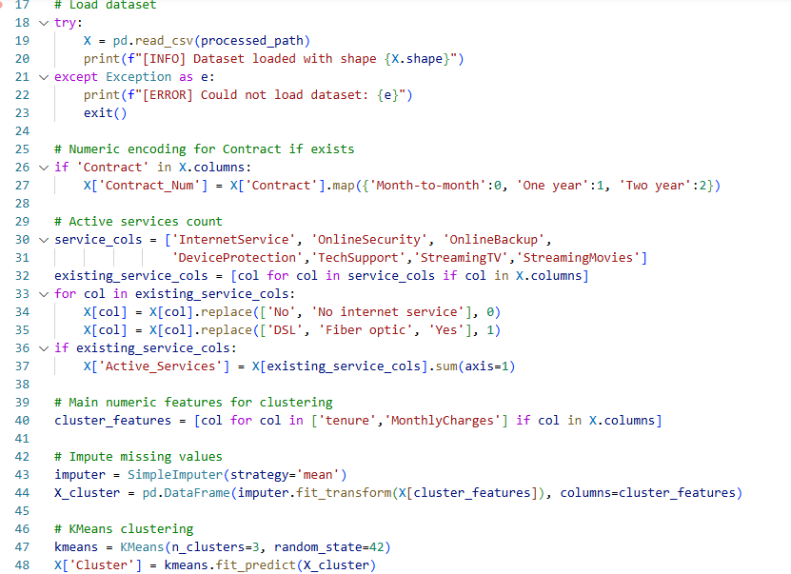
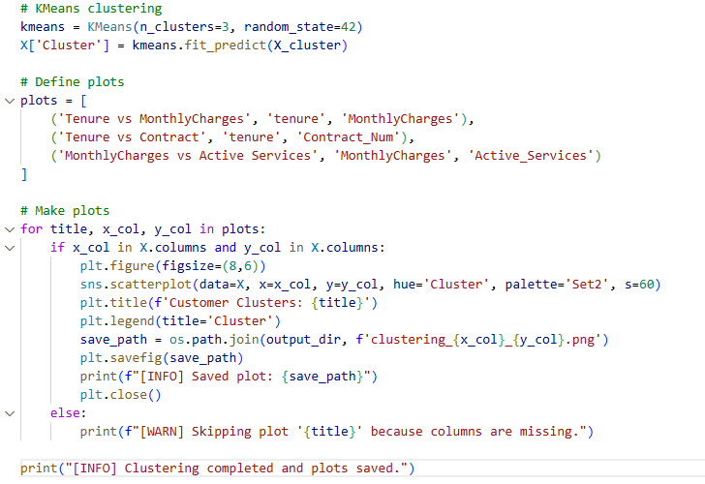
Customer Segmentation Using Clustering

Slide 29
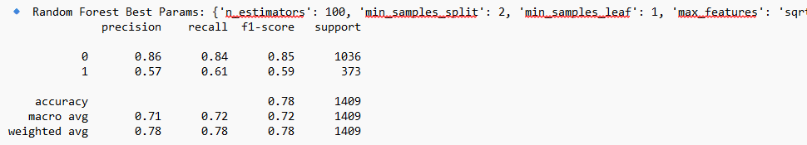
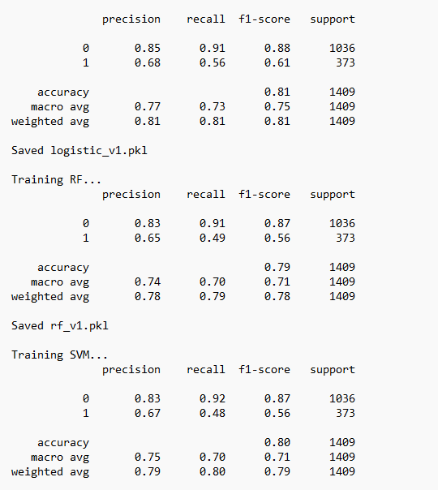
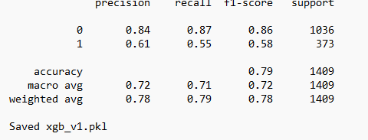
Initial Output (without hyperparameter tuning)

Slide 30
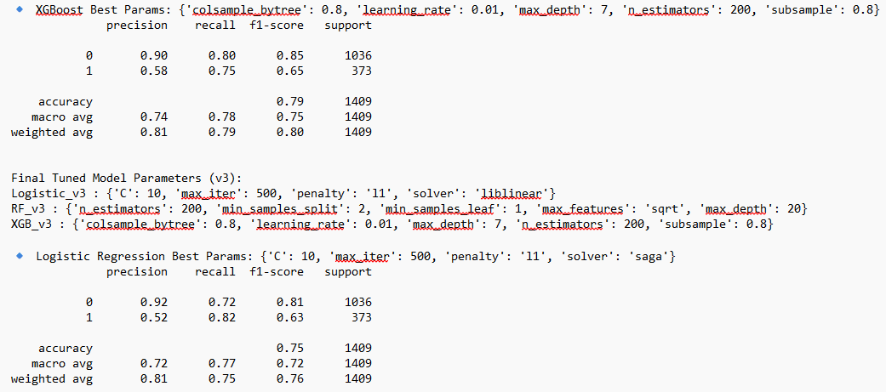
Output (with GridSearch CV)

Slide 31
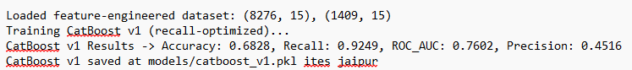
We improved recall to 92% by:
Leveraging categorical features like Contract and InternetService directly.
Taking advantage of CatBoost’s handling of class imbalance.

Slide 32
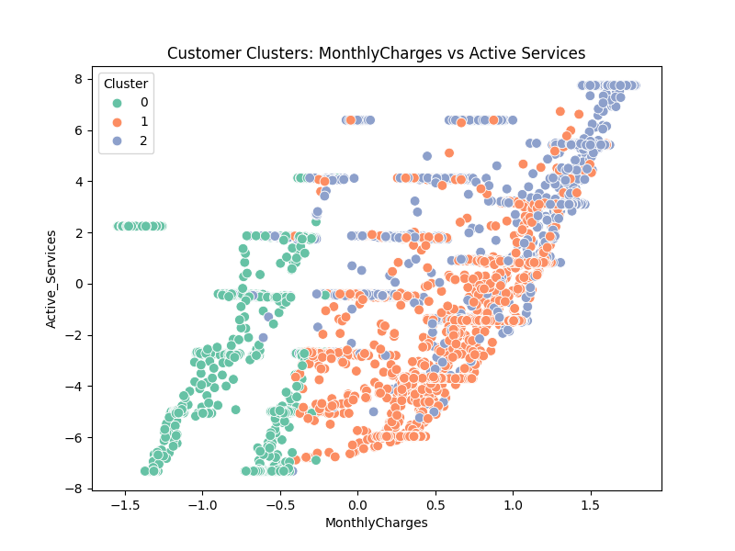
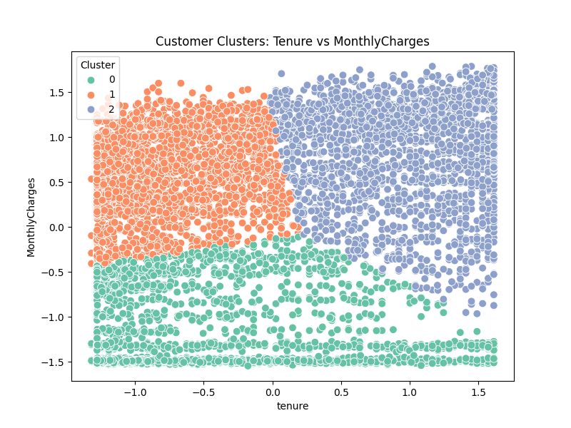
Clustering Output

Slide 33





SHAP Analysis

Slide 34

User Interface & Output

Slide 35



Slide 36

Project Title - Calibri body 18
Pipeline structure

Slide 37
Project Title - Calibri body 18
Approach/Algorithms/Tools
Category Programming AI / ML Visualization Experiment Tracking Web Interface (UI) Deployment | Tools / Tech Stack Python, Jupyter Notebook, FastAPI, Streamlit Scikit‑learn; XGBoost; LightGBM,Logistic Regression (Kaplan–Meier, Cox PH), PySurvival; PyTorch (DeepSurv) Matplotlib, Seaborn, Plotly, SHAP, PowerBI MLflow / Weights & Biases Streamlit (frontend); FastAPI (backend API) Docker, GitHub Actions (CI/CD), AWS / GCP / Azure Cloud

Slide 38
Project Title - Calibri body 18
References
Katzman et al., 'DeepSurv' (BMC Med Res Methodol, 2018): Deep neural net extension of Cox PH for personalized risk. (Use for DeepSurv methodology)
Singh, 'Survival-based predictive analytics for customer churn' (2024 thesis): Evaluates classical and neural survival models for churn prediction (useful comparison & evaluation metrics).
Additional resources: Databricks survival analysis accelerator; ACM paper on deep survival analysis for churn.
Industry sources: Netflix, AXA, Swiss Re, Allkenso, Pfizer
Data Source: https://www.kaggle.com/datasets/blastchar/telco-customer-churn

Slide 39
THANKYOU

